Slide 1

Spring Security
각자바스

Slide 2
Contents
Authentication & Authorization
Why Spring Security?
System Issue
Adapt Spring Security
Trial & Error
인증 및 권한 제어
DelegatingFilterProxy & FilterChainProxy
Filter Chaining
Conclusion
Spring Security Filter Chain
OAUTH2 Token Service 구현
Solution
Conclusion
Difference between Authentication and Authorization
Spring Security Dependency
필터 확장 및 등록
동작과정
Authorization 결과물

Slide 3
Authentication & Authorization

Slide 4
Authentication & Authorization
Difference between Authenication and Authorization
Authentication
Authorization
STORE 4
시스템 접근 시, 등록된 사용자인지 여부를 확인하는 것
접근 후, 인증된 사용자에게 권한을 부여하는 것
로그인
권한에 따라 사용 가능한 기능이 제한됨
사용자 등급(일반/VIP/관리자)

Slide 5
WHY SPRING SECURITY?

Slide 6
System Issue
Authentication
Authorization
시스템 접근 시, 등록된 사용자인지 여부를 확인하는 것
접근 후, 인증된 사용자에게 권한을 부여하는 것
로그인
권한에 따라 사용 가능한 기능이 제한됨
사용자 등급(일반/VIP/관리자)
권한 로직의 부재!!

Slide 7
System Issue
F
i
l
t
e
r
D
I
spa
t
che
r
S
e
r
v
l
e
t
Request
I
n
t
e
r
c
e
p
t
o
r
Other Controller
Login Controller
Naver OAuth2 Server
LoginService
Access token
Naver User Info
Session
.setAttribute(“USER”)
Response
ArgumentResolver
비즈니스 로직과 인증/ 권한 로직이 혼재!!

Slide 8






System Issue
로그인 기능 다각화 요구사항 발생

Slide 9
Solution
by Spring Security
권한 부여
로그인 로직 분리
로그인 다각화
USER 권한 /
ADMIN 권한 설정
ADMIN 권한에 따라
보호 리소스로 접근 가능
비즈니스 로직과 인증/권한 로직을 분리
Spring Security Filter로 인해 보호받는 리소스와 완전히 분리
자체 로그인 세션 구현
다양한 OAUTH2 로그인 기능 구현 및 관리 용이
Spring Security로 해결!!

Slide 10
ADAPT SPRING SECURITY

Slide 11
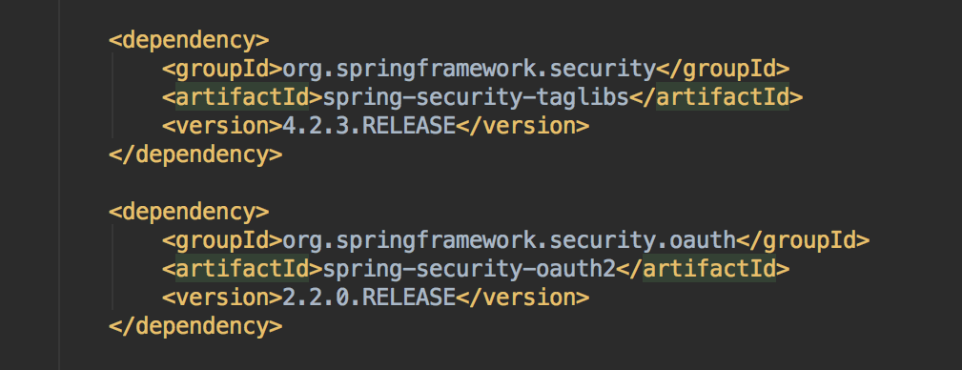
Spring Sercutiy Filter Chain
01
Spring Security Dependency 추가
Spring Security taglibs, Spring Security OAuth2 Dependency 추가

Slide 12
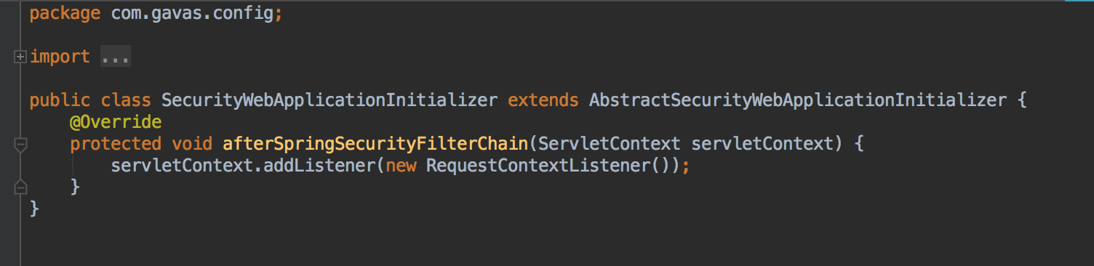
Spring Sercutiy Filter Chain
02
Attach Spring FilterChain
Spring Filter Chain을 등록하기 위한 Class 작성

Slide 13
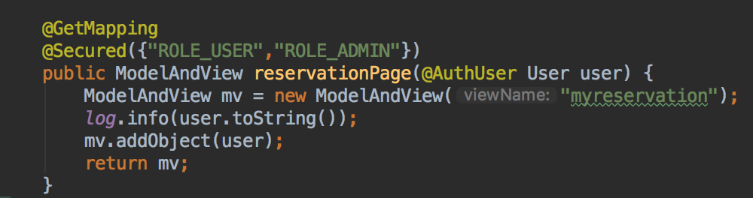
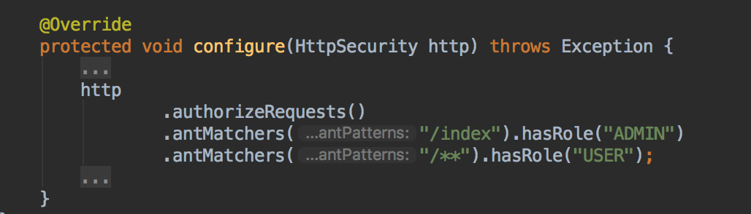
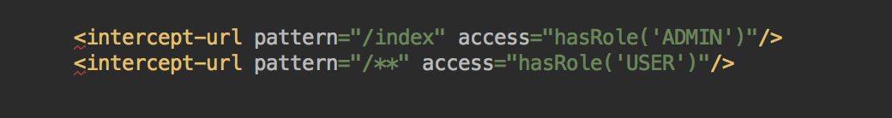
인증 및 권한 제어
03
인증 및 권한 제어 3가지 방법
Secured Annotation
2) Java Configuration
3) xml Configuration

Slide 14
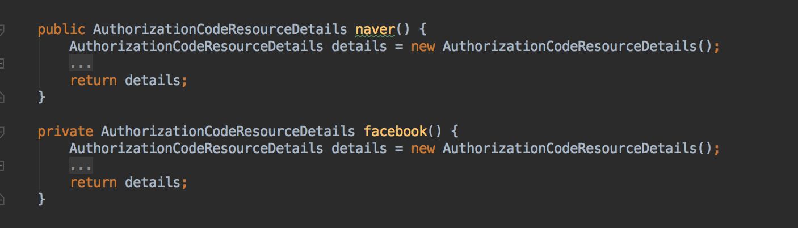
OAuth2를 이용한 Filter 확장 및 등록
1. 다양한 Resource 생성
04
naver, facebook, twitter, kakao, etc.

Slide 15
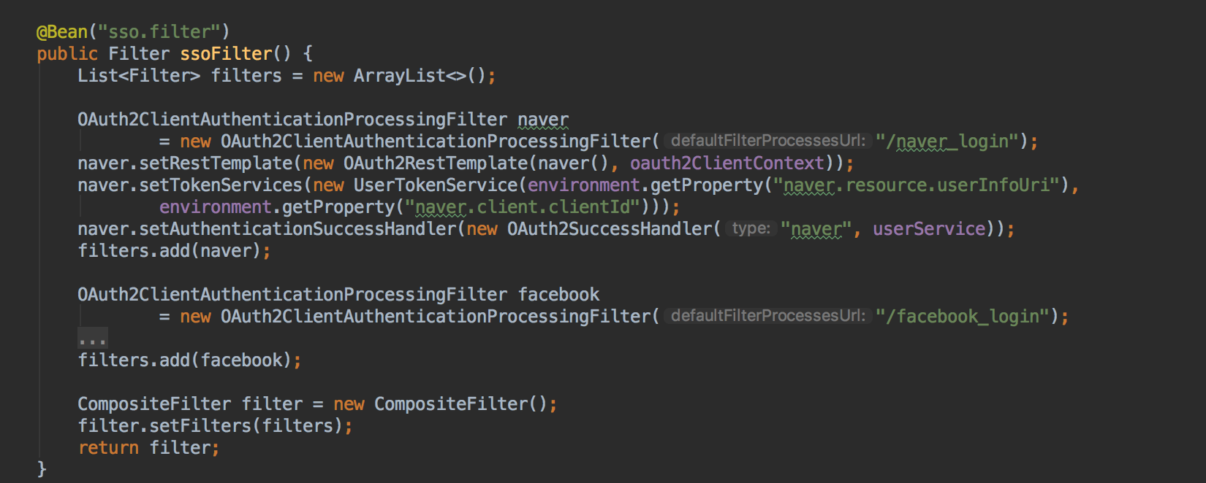
OAuth2를 이용한 Filter 확장 및 등록
2. 서비스별 OAuth2ClientAuthenticationProcessingFilter 생성
05
setRestTemplate, setTokenServices, setAuthenticationSuccessHandler
TITTLE 05
Frequently, your initial font choice is taken out of your hands

Slide 16
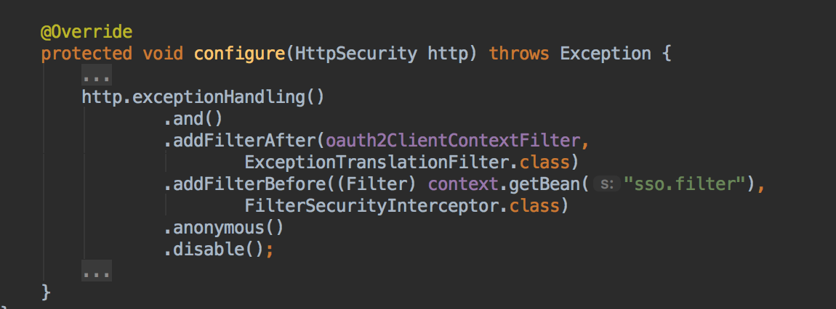
OAuth2를 이용한 Filter 확장 및 등록
3. 생성한 Custom Filter 등록
06
OAuth2ClientContextFilter, Custom Filter 등록
TITTLE 06
Frequently, your initial font choice is taken out of your hands

Slide 17
Solution
by Spring Security
F
i
l
t
e
r
p
r
o
x
y
SpringSecurityFilter
D
I
spa
t
ch
e
r
Se
r
v
l
e
t
Request
Filter Chain
OAuth2AuthenticationProcessingFilter
OAuth2
RestTemplate
Token
Services
OAuth2
SuccessHandler
Response
Service OAuth2 Server
Access token
Service User Info

Slide 18
TRIAL & ERROR

Slide 19
Delegating Filter Chain Proxy
OPTION
TITTLE 02
OPTION
TITTLE 03
02
Frequently, your initial font choice is taken out of your hands
03
Frequently, your initial font choice is taken out of your hands
SecurityContextPersistenceFilter
@Bean
doFilter()
LogoutFilter
springSecurityFilterChain
doFilter()
UsernamePasswordAuthenticationFilter
DefaultLoginPageGeneratingFilter
doFilter()
OPTION
TITTLE 05
OPTION
TITTLE 06
load
delegate
05
06
doFilter()
Frequently, your initial font choice is taken out of your hands
Frequently, your initial font choice is taken out of your hands
DelegatingFilterProxy
FilterChainProxy
BasicAuthenticationFilter
RequestCacheAwareFilter
doFilter()
AnonymousAuthenticationFilter
doFilter()
doFilter()
TITTLE 04
SessionManagementFilter
doFilter()
Frequently, your initial font choice is taken out of your hands
ExceptionTranslationFilter
FilterSecurityInterceptor
doFilter()

Slide 20
Filter Chaining
OPTION
TITTLE 02
OPTION
TITTLE 03
SecurityContextPersistenceFilter
02
Frequently, your initial font choice is taken out of your hands
03
Frequently, your initial font choice is taken out of your hands
LogoutFilter
UsernamePasswordAuthenticationFilter
DefaultLoginPageGeneratingFilter
OPTION
TITTLE 05
OPTION
TITTLE 06
BasicAuthenticationFilter
05
06
Default Spring Security Filter
Frequently, your initial font choice is taken out of your hands
Frequently, your initial font choice is taken out of your hands
RequestCacheAwareFilter
AnonymousAuthenticationFilter
SessionManagementFilter
TITTLE 04
ExceptionTranslationFilter
Frequently, your initial font choice is taken out of your hands
OAuth2ClientContextFilter
FilterSecurityInterceptor
OAUTH2 인증을 위한
필터 확장 및 추가
OAuth2ClientAuthenticationProcessingFilter

Slide 21
Filter Chaining
OPTION
TITTLE 02
OPTION
TITTLE 03
02
Frequently, your initial font choice is taken out of your hands
03
Frequently, your initial font choice is taken out of your hands
Web Browser
Authentication Request
SecurityContextPersistenceFilter
LogoutFilter
TITTLE 05
TITTLE 06
OPTION
OPTION
05
Frequently, your initial font choice is taken out of your hands
06
Frequently, your initial font choice is taken out of your hands
ExceptionTranslationFilter
Handle Exception, Delegate to authentication entry point
OAuth2ClientContextFilter
TITTLE 04
OAuth2ClientAuthenticationProcessingFilter
Frequently, your initial font choice is taken out of your hands
FilterSecurityInterceptor
Throws AuthenticationCredentialsNotFoundException
Exception
Secrued Resource

Slide 22
Filter Chaining
OPTION
TITTLE 02
OPTION
TITTLE 03
02
Frequently, your initial font choice is taken out of your hands
03
Frequently, your initial font choice is taken out of your hands
Web Browser
Authentication Redirect
SecurityContextPersistenceFilter
LogoutFilter
TITTLE 05
TITTLE 06
OPTION
OPTION
05
Frequently, your initial font choice is taken out of your hands
06
Frequently, your initial font choice is taken out of your hands
ExceptionTranslationFilter
OAuth2ClientContextFilter
Handle Exception, Redirect authorization server
TITTLE 04
OAuth2ClientAuthenticationProcessingFilter
Throws UserRedirectRequiredException
Exception
Frequently, your initial font choice is taken out of your hands
FilterSecurityInterceptor
Secrued Resource

Slide 23
Filter Chaining
OPTION
TITTLE 02
OPTION
TITTLE 03
02
Frequently, your initial font choice is taken out of your hands
03
Frequently, your initial font choice is taken out of your hands
Web Browser
Authentication Redirect
SecurityContextPersistenceFilter
LogoutFilter
TITTLE 05
TITTLE 06
OPTION
OPTION
05
Frequently, your initial font choice is taken out of your hands
06
Frequently, your initial font choice is taken out of your hands
ExceptionTranslationFilter
OAuth2ClientContextFilter
TITTLE 04
OAuth2ClientAuthenticationProcessingFilter
Exchanges authorization code with access token.
Creates authentication object and stores it in session.
Frequently, your initial font choice is taken out of your hands
FilterSecurityInterceptor
Success!!
Success
Secrued Resource

Slide 24
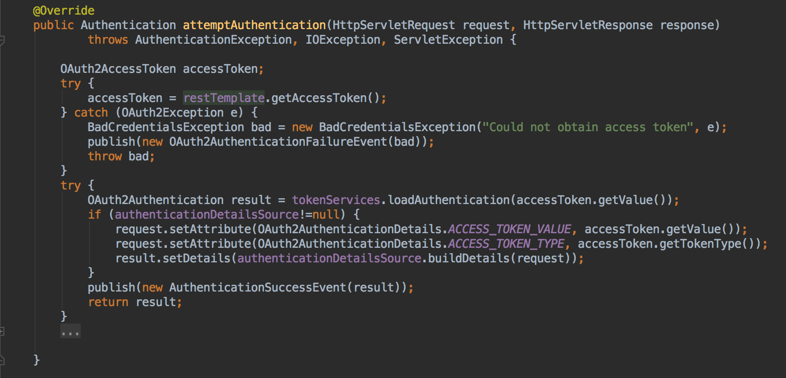
OAuth2 Service Logic 구현
AbstractAuthenticationProcessingFilter
+ attemptAuthentication: Authentication
OAuth2ClientAuthenticationProcessingFilter
OAuth2RestOperations restTemplate
ResourceServerTokenServices tokenServices
+ attemptAuthentication: Authentication
<<Interface>>
ResourceServerTokenServices
+ loadAuthentication : OAuth2Authentication
…
UserTokenService
+ loadAuthentication : OAuth2Authentication
…

Slide 25
Conclusion
권한 로직 추가 및 Admin 페이지 적용
비즈니스 로직과 인증 / 권한 로직을 분리
로그인 방법 다각화
필터 확장 및 등록으로 인증/세션 관리 기능을 서비스에 맞게 커스텀 가능
추후 LDAP, SSO 등 다양한 로그인 방법 및 자동 로그인, 세션 관리 등을 더 학습하고 적용할 예정

Slide 26
THANK YOU!!
by 각자바스

